Slide 1
Heart Disease Prediction
Allison Yang

Slide 2
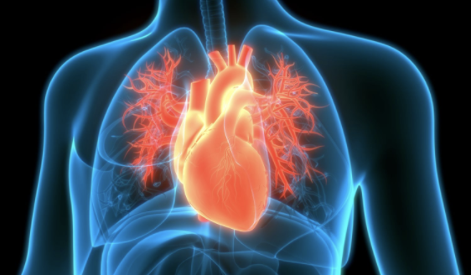
Motivation
Cardiovascular diseases (CVDs) are the NO.1 cause of death globally, taking an estimated 17.9 million lives each year, which accounts for 31% of all deaths worldwide. Four out of five CVD death are due to heart attacks and strokes. People with heart disease or who are at high risk need early detection and management. Common factors that are related to the heart disease are: age, chest pain type, cholesterol volume, etc.

Slide 3
Can machine learning help predict whether or not a person has heart disease given certain biological characteristics or results from physical examinations?

Slide 4
Data Acquisition

Slide 5
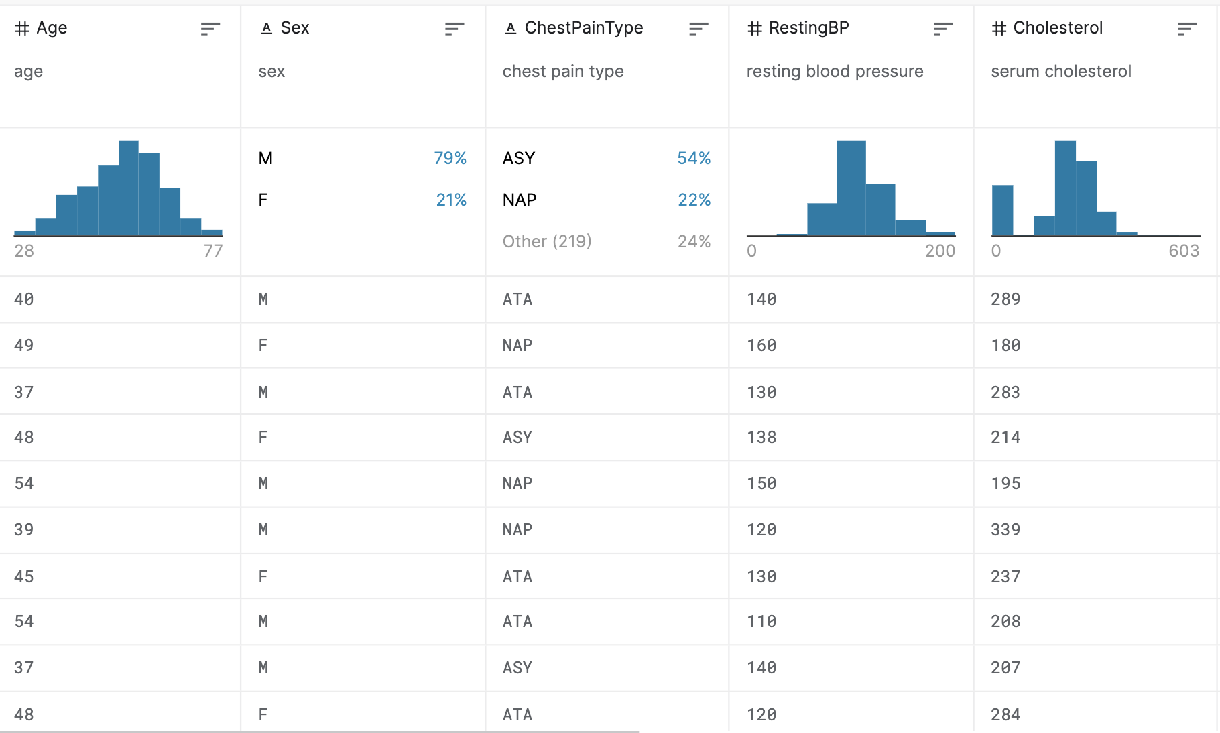
Data acquisition
There is a dataset for heart disease prediction from Kaggle. This dataset contains a total of 918 observations and 11 attributes used for prediction (Age, Sex, ChestPainType, RestingBP, etc). This dataset is combined from five available independent datasets (Cleveland, Hungarian, Switzerland, Long Beach VA and Stalog (Heart) Data Set), which can be found from UCI Machine Learning Repository in the following link (https://archive.ics.uci.edu/ml/machine-learning-databases/heart-disease/). The fact of combination during its curaton makes it the largest heart disease dataset available so far for research purposes.

Slide 6
Data acquisition
Split the original dataset into training set and testing set with test_size = 0.3.
Dataset information:
Training set: roughly 358 positive examples and 284 negative examples.
Testing set: roughly 150 positive examples and 126 negative examples.
The set can be regarded as balanced between the two classes.

Slide 7
Data Analysis

Slide 8
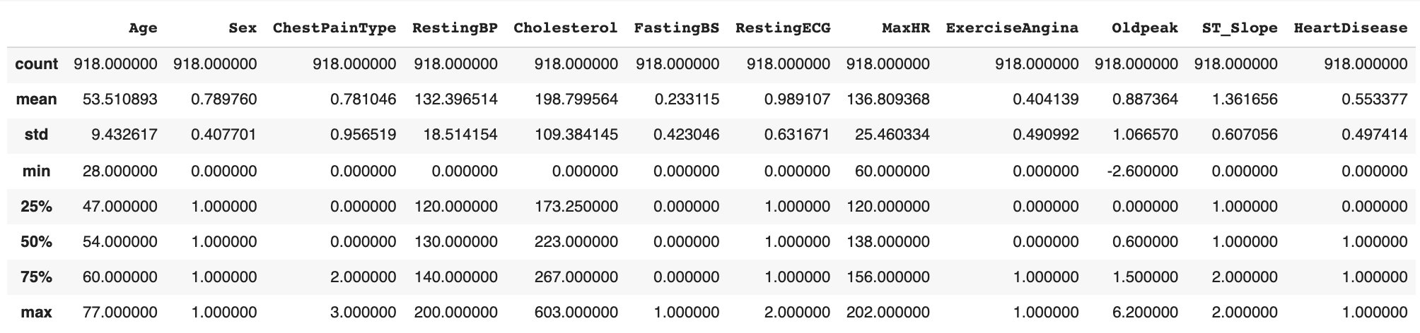
Statistics

Slide 9
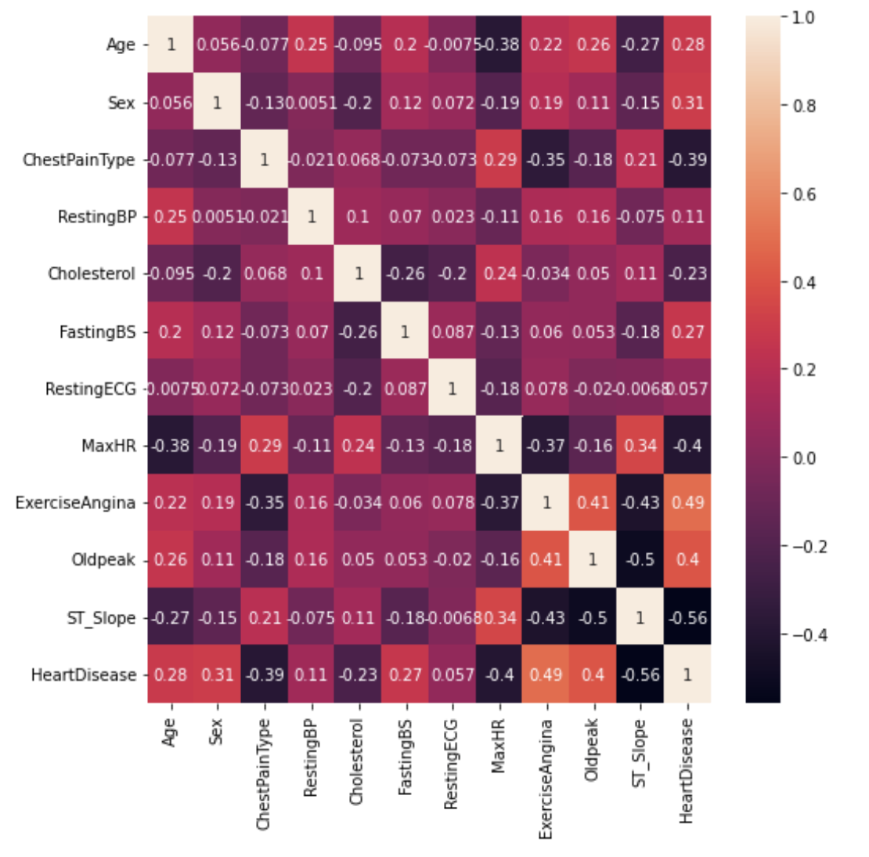
Correlations between attributes

Slide 10
Approach

Slide 11
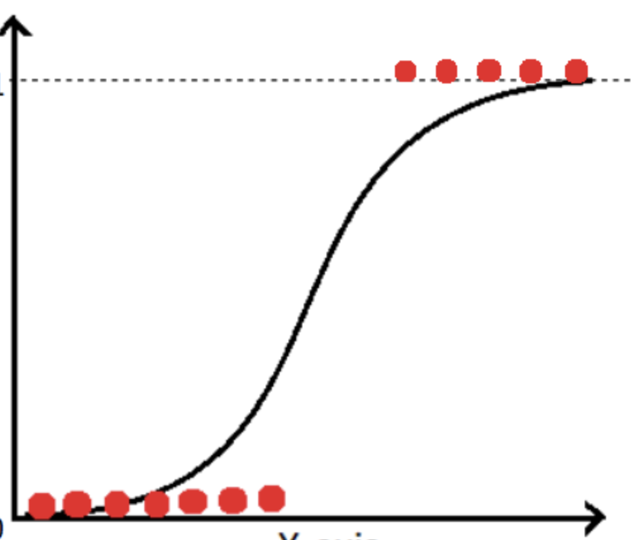
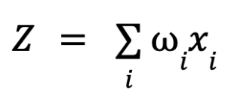
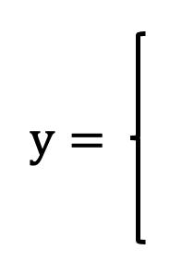
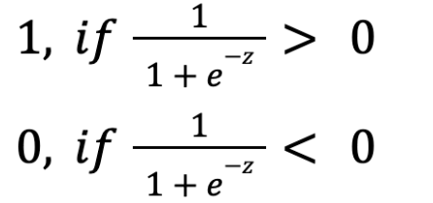
Build a Logistic Regression model
It is a classification problem. The main approach is logistic regression.
Let
Xis are the attributes used to predict the heart disease, and wis are the parameters learned from historical data.

Slide 12
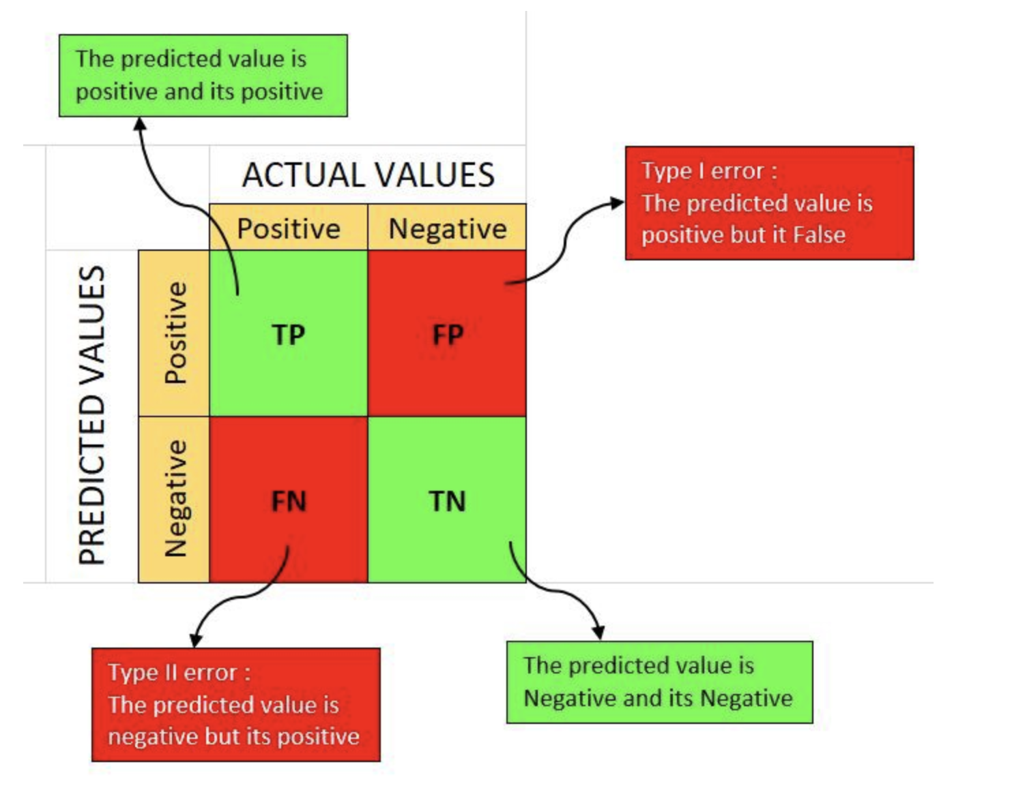
Model evaluation
Run the Logistic Regression model.
Use the overall accuracy and confusion matrix as the metrics for evaluation.
Overall accuracy = 0.8551
Confusion Matrix:
 | Actual Positive | Actual Negative
Predicted Positive | 133 (TP) | 23 (FP)
Predicted Negative | 17 (FN) | 103 (TN)

Slide 13
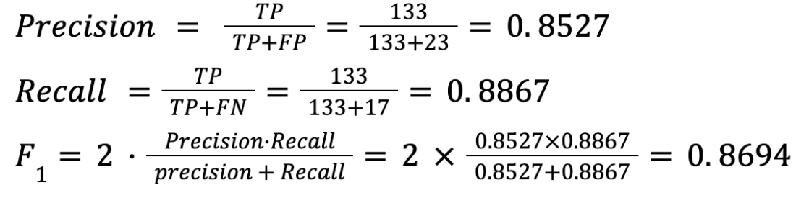
Model evaluation
 | Actual Positive | Actual Negative
Predicted Positive | 133 (TP) | 23 (FP)
Predicted Negative | 17 (FN) | 103 (TN)

Slide 14
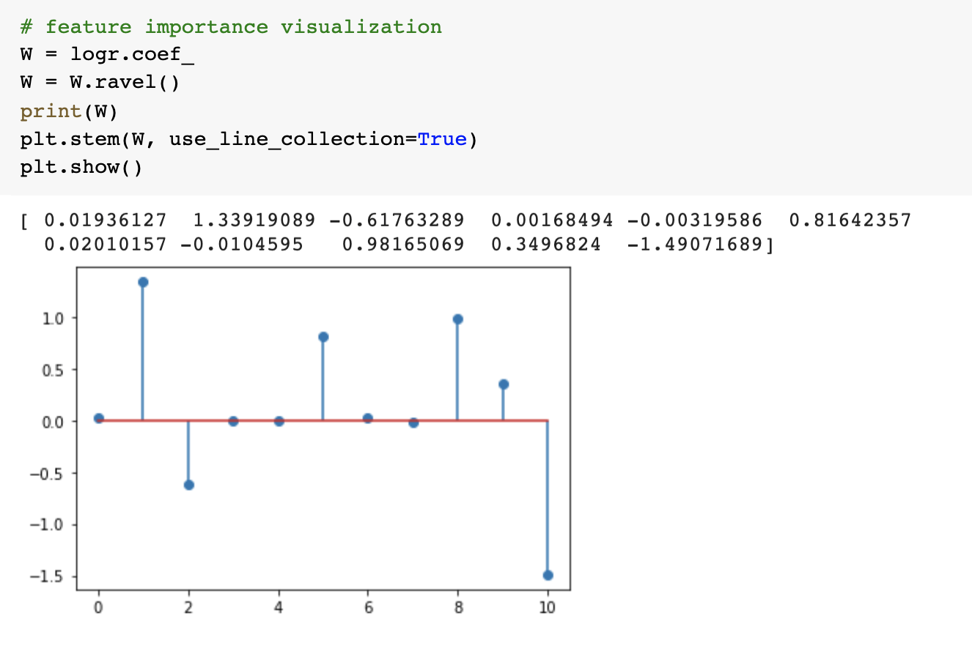
Feature importance visualization

Slide 15
Comparison with other approaches — Support Vector Machine
With the Support Vector Machine:
Overall accuracy = 0.7246
Confusion Matrix:
Precision = TP/(TP+FP) = 113/(113+39) = 0.7434,
Recall = TP/(TP+FN) = 113/(113+37) = 0.7533,
F1 score = 2*Precision*Recall/(Precision+Recall)=2*0.7434*0.7533/(0.7434+0.7533) = 0.7483.
 | Actual Positive | Actual Negative
Predicted Positive | 113 (TP) | 39 (FP)
Predicted Negative | 37 (FN) | 87 (TN)

Slide 16
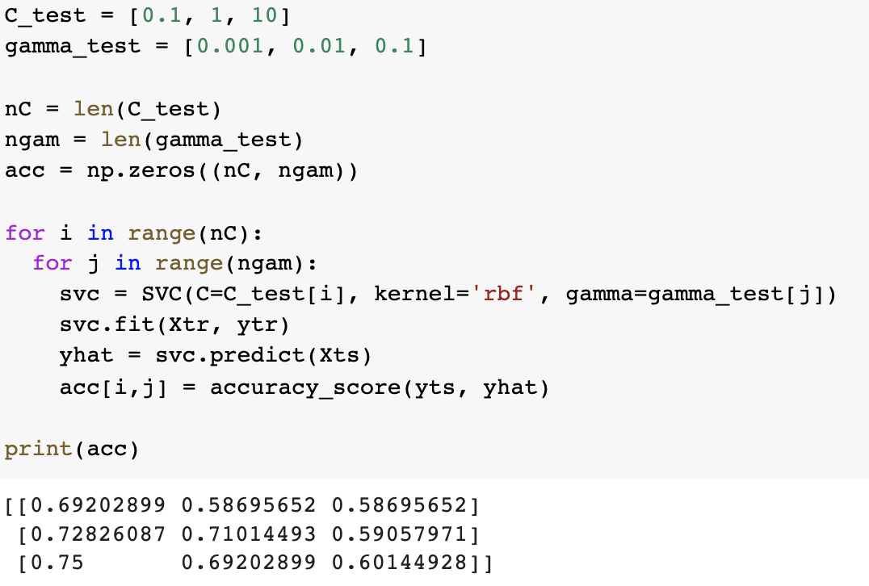
Support Vector Machine with parameter selection

Slide 17
Support Vector Machine with parameter selection
Support Vector Machine with parameter selection:
Overall accuracy = 0.75
Confusion Matrix:
Precision = TP/(TP+FP) = 124/(124+31) = 0.8,
Recall = TP/(TP+FN) = 124/(124+38) = 0.7654,
F1 score = 2*Precision*Recall/(Precision+Recall)=2*0.8*0.7654/(0.8+0.7654) = 0.7823.
 | Actual Positive | Actual Negative
Predicted Positive | 124 (TP) | 31 (FP)
Predicted Negative | 38 (FN) | 83 (TN)

Slide 18
Comparison with other approaches — Decision Tree
With the Decision Tree Classifier:
Overall accuracy = 0.7899
Confusion Matrix:
Precision = TP/(TP+FP) = 121/(121+29) = 0.8067,
Recall = TP/(TP+FN) = 121/(121+29) = 0.8067,
F1 score = 2*Precision*Recall/(Precision+Recall)=2*0.8067*0.8067/(0.8067+0.8067) = 0.8067.
 | Actual Positive | Actual Negative
Predicted Positive | 121 (TP) | 29 (FP)
Predicted Negative | 29 (FN) | 97 (TN)

Slide 19
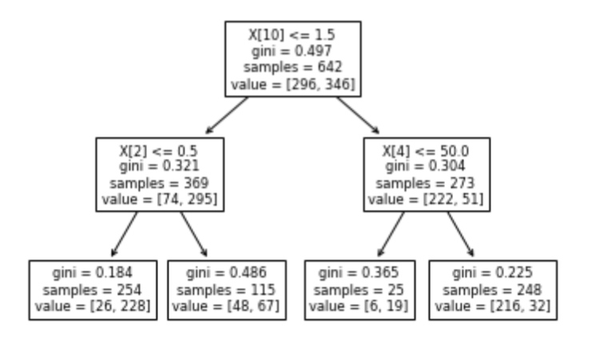
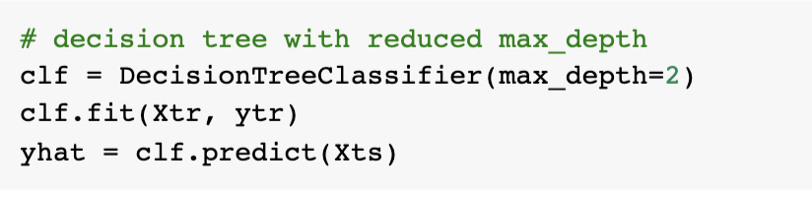
Decision Tree with reduced max_depth
Decision Tree may suffer from the overfitting problem. Thus, we reduce the max_depth value of the decision tree and select the best max_depth value for this problem.
Let max_depth = 2:

Slide 20
Decision Tree with reduced max_depth
With the Decision Tree Classifier:
Overall accuracy = 0.8587
Confusion Matrix:
Precision = TP/(TP+FP) = 149/(149+26) = 0.8514,
Recall = TP/(TP+FN) = 149/(149+13) = 0.9198,
F1 score = 2*Precision*Recall/(Precision+Recall)=2*0.8514*0.9198/(0.8514+0.9198) = 0.8843.
 | Actual Positive | Actual Negative
Predicted Positive | 149 (TP) | 26 (FP)
Predicted Negative | 13 (FN) | 88 (TN)

Slide 21
Comparison with other approaches — Neural Network
With the Neural Network:
Overall accuracy = 0.7283
Confusion Matrix:
Precision = TP/(TP+FP) = 117/(117+42) = 0.7358,
Recall = TP/(TP+FN) = 117/(117+33) = 0.78,
F1 score = 2*Precision*Recall/(Precision+Recall)=2*0.7358*0.78/(0.7358+0.78) = 0.7573.
 | Actual Positive | Actual Negative
Predicted Positive | 117 (TP) | 42 (FP)
Predicted Negative | 33 (FN) | 84 (TN)

Slide 22
Comparison with other approaches
 | Accuracy | Precision | Recall | F1 score
Logistic Regression | 0.8551 | 0.8527 | 0.8867 | 0.8694
Support Vector Machine | 0.7246 | 0.7434 | 0.7533 | 0.7483
Support Vector Machine (with parameter selection) | 0.7500 | 0.8000 | 0.7654 | 0.7823
Decision Tree | 0.7899 | 0.8067 | 0.8067 | 0.8067
Decision Tree (with reduced max_depth value) | 0.8587 | 0.8514 | 0.9198 | 0.8843
Neural Network | 0.7283 | 0.7358 | 0.7800 | 0.7573

Slide 23
Conclusion & Discussion

Slide 24
Conclusion & Discussion
This dataset is rather balanced. Hence, for different models, the values of precision, recall and F1 score are close to the overall accuracy.
According to the evaluations, the logistic regression model and Decision Tree with reduced max_depth values achieves the highest accuracy (precision, recall, F1 score), which is over 85%, which means that they are good models for predicting heart disease (a classification problem). The other models (support vector machine, decision tree and neural) achieve lower accuracies (precision, recall, F1 score), which are between 70% and 80%.
We can see that the performance of the decision tree can be significantly improved by reducing the max_depth value, which indicates that the original decision tree may suffer from the overfitting problem.
The performance of the support vector machine model can also be slightly improved by selecting proper parameters.
Future work: in order to better test the precision and recall of the models, an unbalanced dataset is desired. To obtain such a dataset, we can synthesize certain amount of negative examples and add them to the original dataset. Then, we can apply the models on this new dataset to gain more accurate evaluations of them.
There are less than 1000 observations in the original dataset, perhaps a larger dataset is desired for better results.

Slide 25
Citation
fedesoriano. (September 2021). Heart Failure Prediction Dataset. Retrieved [Date Retrieved] from https://www.kaggle.com/fedesoriano/heart-failure-prediction.

